Slide 1
Knowing and Showing Your True Colors
Abby DiPasquale, MPH, MCHES
Wellness Works
1-800-852-8300
adipasquale@memun.org

Slide 2
Knowing True Colors
Imagine the people you interact with daily.
Do you always understand how and why they do what they do?
We all have different ways of doing things, so how do we bring out the best in each other instead of driving each other crazy?
That is the power of knowing your True Colors!

Slide 3
The Steps
Identify
Clarify
Modify
Apply
Verify

Slide 4
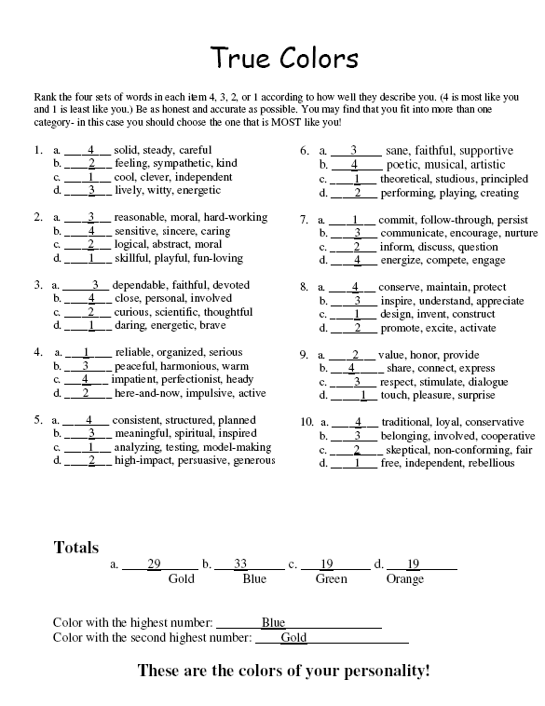
Identify
Rank each group of words. 1= least like you and 4= most like you.
For each question you must have a 1,2, 3, and 4.
Focus on how you are when you are most “you”- not how you wish you were or how others say you are.
Add up all numbers in the “a”, “b”, “c” and “d” and total at the bottom.

Slide 5
Clarify
Circle 3-5 words from the quiz that you identify with the most.
Turn to the first page of your Color and read the brief description written there…does this sound like you?
Don’t read the whole book- not yet anyway!

Slide 6
Predictable
Be Prepared
Be Prepared
Be Prepared
Gold
Follows Rules
Duty and Responsibility

Slide 7
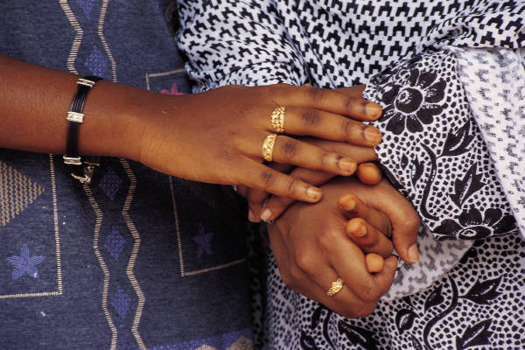
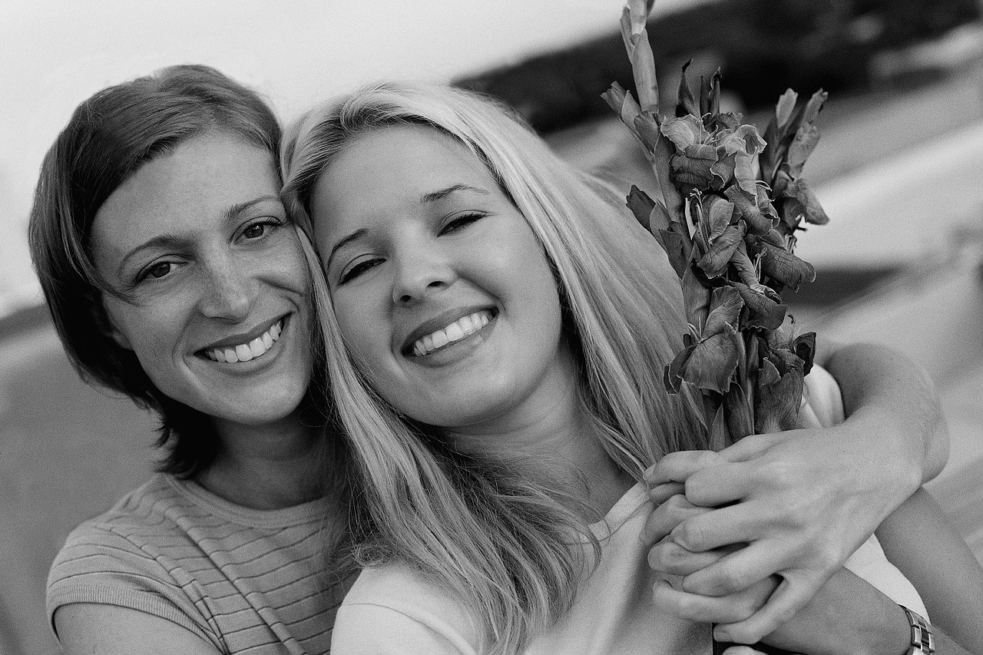
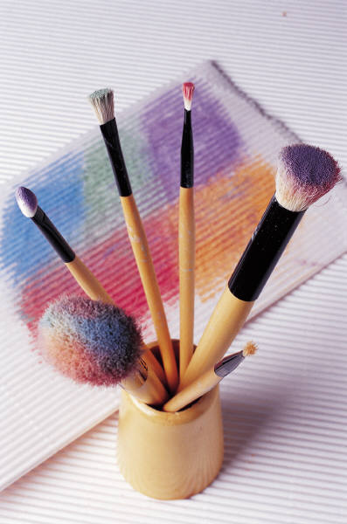
Blue
Optimistic
Relationships
Driven by Emotions
Peacemaker
Caretaker

Slide 8
Pushes Boundaries
Playful
Orange
Spontaneous
Variety

Slide 9
Green
Why?
Strategic
Innovative
Intellectual
Determined

Slide 10
“We don’t see things as they are; we see them as we are.”
- Anaïs Nin

Slide 11
Modify
We don’t want to change or hide our colors, we want to show them!
But how do we meet them where they are and where we are?
Take a moment to consider that their reality may be valid and you may benefit from understanding it!

Slide 12
Apply to Gold
The Gold Style:
What You Should Do:
Purposeful, plans ahead
Respectful, appropriate
Supportive of policies and rules
Detail oriented, chronological
Loyal, devoted
Be prepared, give details
Stay on target, be consistent
Show respect
Don’t interrupt
Recognize their contributions

Slide 13
Apply to Blue
The Blue Style:
What You Should Do:
Friendly, helpful, empathetic
Optimistic
Expressive with emotion
Fostering or maintaining harmony
May use metaphors to embellish points
Acknowledge them
Show appreciation
Include them
Have patience
Don’t “bark” orders

Slide 14
Apply to Orange
The Orange Style:
What You Should Do:
Casual, playful
Spontaneous, now oriented
Fast-paced, changes subjects quickly
Straightforward
Active, involved, mobile
Use “sound bites”
Move with them while they multitask
Appreciate their flair
Allow options for flexibility
Lighten up

Slide 15
Apply to Green
The Green Style:
What You Should Do:
Logical and objective
Includes facts and information
Big picture, conceptual
Questioning, critiquing
Wry sense of humor
Allow them to ponder
Skip the “small talk”
Avoid redundancy
Give big picture or point first, then fill in details if asked
Don’t misinterpret their need for info as interrogation

Slide 16
Verify
The more aware we are of our own personality and that of others, the better we are at adapting and modifying our interactions.
Check with the other personalities to determine how they view a situation and identify solutions.
Look at it from a new perspective and keep and open mind!

Slide 17
Continue to Explore and Learn About Your True Colors!

